Slide 1

PREDICTING CUSTOMER BUYING BEHAVIOUR
20/11/2022

Slide 2
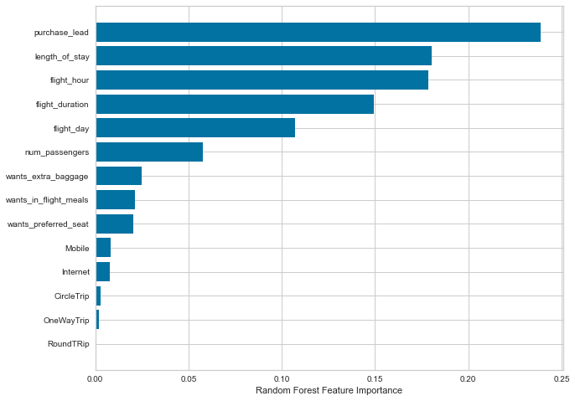
Predictive Model Summary
Evaluation Summary:
The most crucial variable in the model was "purchase_lead," representing the time between purchase and departure. This variable exhibited the highest importance in predicting customer bookings.
Information related to the flight, including attributes such as flight time and duration, also played a significant role in the model's predictive power.
Surprisingly, the "booking origin" of the customer did not contribute significantly to the model's performance.
The accuracy of the model was approximately 0.62 (Precision), indicating its ability to correctly classify positive cases. However, the Recall was 0.58, suggesting that the model has limited capability in identifying all positive cases.
To enhance model performance, it is advisable to incorporate additional customer-centric features, which can provide a more comprehensive view of customer behavior and booking patterns. This can lead to improved predictive accuracy and a better balance between Precision and Recall.
Top features that can drive successful flight bookings.

